Slide 1
MOVIE INDUSTRY ANALYSIS: Analyzing Box Office Trends to inform Film Production Decisions.
AN ANALYSIS BY RIOPA MARGRET NAMUNYAK

Slide 2
OVERVIEW
The purpose of this analysis is to provide strategic insights for a new movie studio aiming to succeed in the competitive film industry. By examining key factors such as production budgets, box office revenues, genre performance, and audience ratings, the analysis identifies trends and patterns that can guide the studio in making informed decisions about film production. The goal is to understand what types of films perform best at the box office and how various elements like budget allocation, genre selection, and market strategies influence a film's success. These insights will help the studio optimize its investments, maximize profitability, and cater to audience preferences effectively

Slide 3
BUSINESS UNDERSTANDING
The primary objective of this project is to explore and analyze the current box office trends to identify the types of films that are currently achieving the most success. This analysis will be translated into actionable insights that will guide the strategic decisions of our new movie studio.¶
Specifically, we aim to:
Identify the genres and themes that are currently popular.
Understand the financial dynamics of film production, including budget-to-revenue relationships.
Determine the optimal timing for film releases.
Analyze audience demographics and preferences.
By understanding the key factors that contribute to a film's success, we can make informed decisions about the genres, themes, and target audiences that will maximize our chances of producing commercially successful films.

Slide 4
DATA UNDERSTANDING
The data for this analysis is sourced from three online movie databases:
Box Office Mojo
Provides detailed box office revenue data for films.
Internet Movie Database (IMDb)
IMDb is a comprehensive online database offering movie information, statistics, and user ratings. The dataset comprises multiple tables, and for this analysis, two tables were used: one with basic movie data and another with user ratings. The key data points include the release date, runtime (in minutes), and average rating. Contains information on genres, cast, crew, ratings, and review
The Movie Database (TMDB)
TMDB is a user-generated database containing detailed information about movies and user ratings. The dataset includes 26,517 entries and 9 data columns. The key data points are the release date and genre, with genre codes sorted by relevance.
The Numbers (TN)
The TN dataset provides box office information for 5,782 movies. The key data points include the release date, production budget, and worldwide gross revenue.

Slide 5
DATA ANALYSIS
Our Analysis Involved Several Key Steps:
Data Cleaning: We handled missing values, checked for duplicates, and resolved any structural issues in the dataset to ensure accuracy and reliability.
Exploratory Analysis: We examined various factors such as production budgets, worldwide gross revenues, ROI (Return on Investment), genre performance, and audience ratings. This helped us understand what types of films are currently performing best at the box office.
Graphs and Visualizations: We created multiple visualizations to better understand the data. For instance:
Bar Charts: Displayed the top 10 studios by total worldwide gross revenue to identify which studios are performing the best financially.
Scatter Plots: Illustrated the relationship between production budget and worldwide gross revenue, revealing a positive but not perfect correlation.
Bar Charts for ROI: Showed the return on investment for top-performing movies, highlighting films that generated the most profit relative to their budgets.
Stacked Bar Charts: Compared domestic and foreign gross percentages for the top 10 movies, providing insights into market performance across different regions.
These steps allowed us to draw meaningful conclusions and provide actionable recommendations for the new movie studio to optimize their film production strategies.

Slide 6
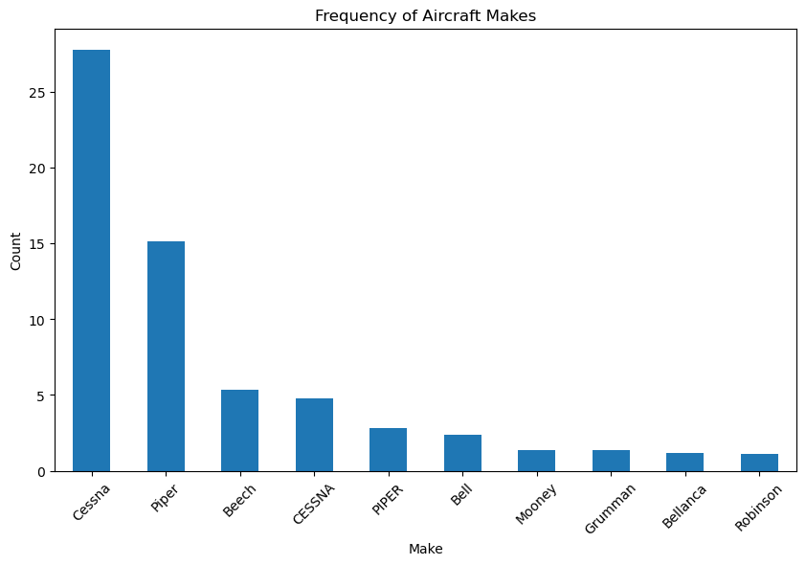

Slide 7
BAR CHART

Slide 8
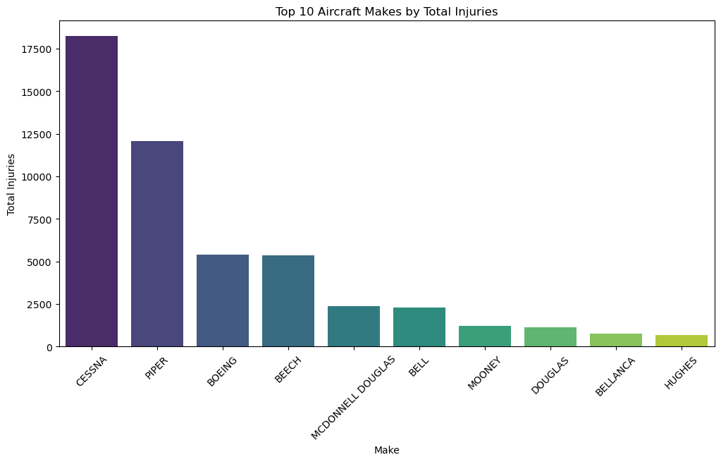
Bar chart
Showing the frequency of top 10 aircraft makes by Total Injuries

Slide 9
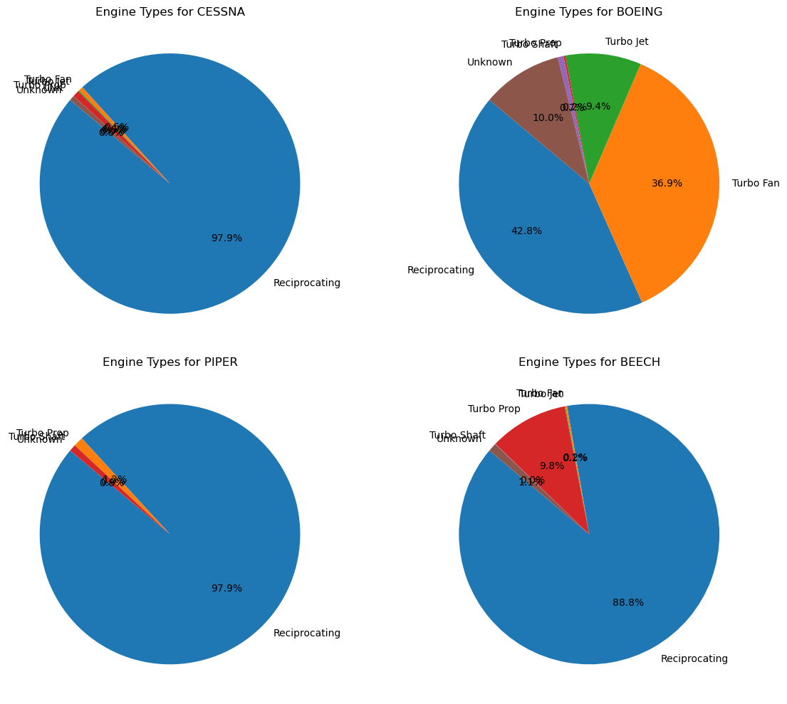
PIE CHART
Illustrating the proportion of different engine types used by various aircraft makes.

Slide 10
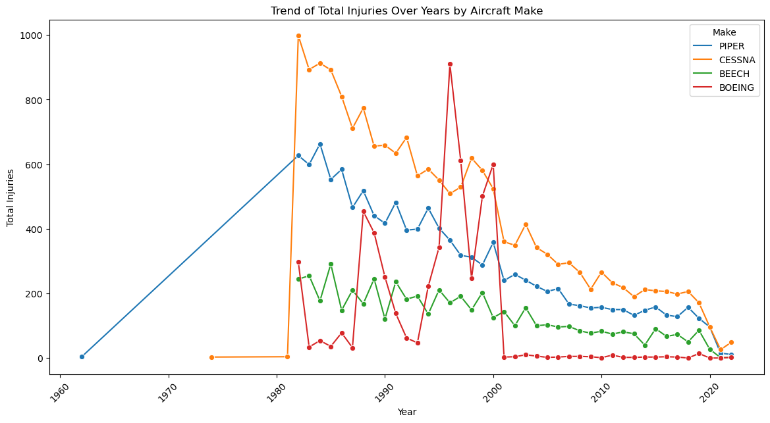
LINE CHART
Displaying the trend of Total Injuries over Years by Aircraft Make.

Slide 11
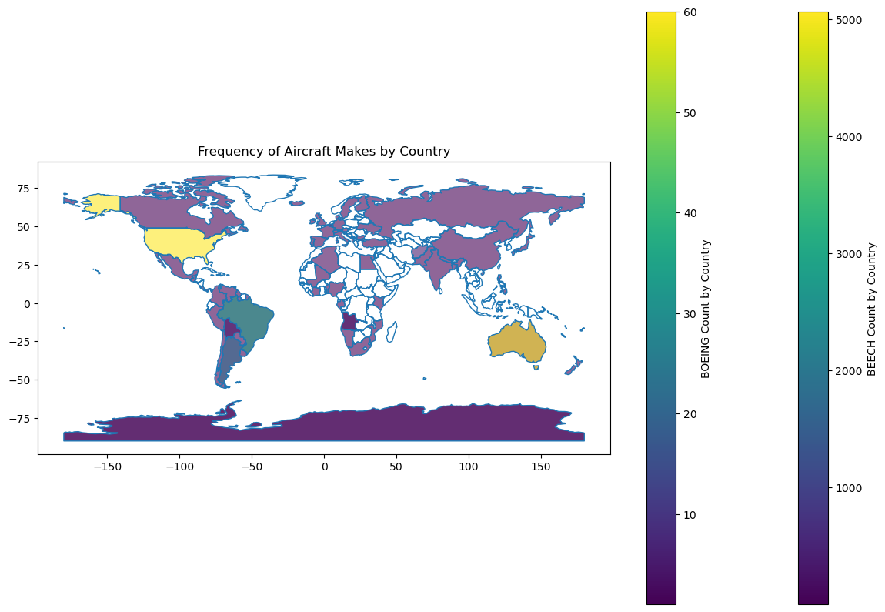
GEOGRAPHICAL PLOT
Displayed the frequency of Aircraft Makes by country

Slide 12
RECOMMENDATIONS
Focus on High-Grossing Genres and Studios:
Prioritize genres and movie types that have historically performed well in terms of worldwide gross revenue. According to our findings, studios like BV (Buena Vista) and Universal (Uni) have produced some of the highest-grossing movies, including 'Avengers: Infinity War,' 'Jurassic World,' and 'Furious 7.'
Balance Between Production Budget and ROI:
While aiming for high worldwide gross revenue, it is also essential to manage production budgets effectively to ensure a strong return on investment (ROI). Set realistic budgets for productions while maintaining high-quality standards.
Movies like 'Frozen' and 'Furious 7' demonstrated significant profitability with ROIs of 7.48 and 6.99, respectively. Carefully evaluate potential projects to balance production costs and expected revenue
Leverage Viewer Preferences in Genres and Runtimes:
Cater to viewer preferences for both high-rated genres and suitable runtimes. Genres such as short films, documentaries, and biographical content have high average ratings.
Diversify our film portfolio to include a mix of genre types. While blockbuster action and adventure films can drive high revenue, incorporating highly-rated genres like documentaries and short films can enhance our brand reputation and attract diverse audiences.
Target Both Domestic and International Markets:
Plan for a balanced approach to earning revenue from both domestic and foreign markets. Our analysis shows that successful movies have substantial earnings from international audiences.
Develop marketing strategies tailored to different regions, leveraging cultural trends and preferences. Consider international partnerships for co-productions to enhance global appeal.

Slide 13
NEXT STEPS
To continue improving aviation safety, we suggest the following next steps:
Implementing Safety Recommendations: Work with aviation authorities to implement the recommended safety measures.
Ongoing Data Collection and Analysis: Continue to collect and analyze data to monitor the effectiveness of implemented safety measures and to identify new trends or risks.
Collaboration with Aviation Experts: Engage with industry experts to refine safety protocols and training programs based on the latest findings and technological advancements.

Slide 14
THANK YOU
Thank you for your attention. We look forward to implementing these findings to enhance our aviation safety and operational efficiency.
This project is available on my github (https://github.com/Namnyak/FINAL-PROJECT).
My contact info: kinyeinamnyak@gmail.com

